Slide 1
REDUCING RISK WHILE SHARING IT: A FISCAL RECIPE FOR THE EU AT THE TIME OF COVID
Nicoletta Batini,¹ Francesco Lamperti,² Andrea Roventini³
1 Independent Evaluation Office, International Monetary Fund
2 Institute of Economics and EMbeDS, Scuola Superiore Sant'Anna and RFF-CMCE European Institute on Economics and the Environment
3 Institute of Economics and EMbeDS, Scuola Superiore Sant'Anna and OFCE, Sciences Po
Disclaimer: The views expressed here are those of the authors and do not necessarily represent the views of the IMF, its Board or Management, nor those of the IMF’s Independent Evaluation Office.

Slide 2
STIMULUS DEBATE
“Large”
Draghi 2020, IMF 2020, Kapoor & Buiter 2020, Stiglitz 2020
“Paced”
Romer & Garber 2020, Krugman 2020, Grith-Jones et al. 2020
“Green”
Bozuwa et al. 2020, Hepburn et al. 2020, Biden, 2020, EU 2020 Georgieva 2020

Slide 3
EU’S FISCAL CHALLENGES
COVID-19 lockdowns → need of large fiscal responses in all European countries.
But common budgetary rules not calibrated for swan-type events, and no risk sharing
Further:
Asymmetric pandemic shock
Varied economic conditions, including initial conditions
Dispersion in fiscal space

Slide 4
ASYMMETRIC

Slide 5
FISCAL SPACE (and hazard)

Slide 6
LITERATURE
Member country needs financial resources to cope with the pandemic
(Draghi 2020, Blanchard 2020, Baldwin et al. 2020)
Account for moral hazard (Cottarelli et al. 2020, Perotti 2020, Persson and Tabellini 1994 vs. Boot et al. 2020)
Account for sovereign debt risk (Arellano et al. 2020, EU 2020) “when a sovereign or a corporate is already highly indebted, adding on further indebtedness can lead to long run problems of debt overhang” (Benassy-Quere and Weder di Mauro, 2020)
EU can design a system of fiscal integration based on risk sharing and centralization (Benassy-Quere and Weder di Mauro, 2020) and bail-out a sovereign at risk (Berger et al. 2019).

Slide 7
EU’s RESPONSE & RISK SHARING

Slide 8
THIS PAPER
Is risk sharing—as envisaged by EU’s response to COVID-19—desirable in the sense that it is both efficient (adequate support to individual countries) and economical (takes account of moral hazard) ?
To this end we study the interaction between a European member country and the EU, start from Berger et al (2019)
EU observes government action after shock and decides to intervene if expected payoff with risk sharing bigger than without (cost both ways)
Expected ‘help’ creates moral hazard that can be alleviated through delegation but this is also costly
We allow COVID-19-related debt to take various levels and make the probability of default a function of this
NEW

Slide 9
KEY MESSAGES SO FAR
EU Treaty’s “no-bail-out" clause not credible (Berger et al. 2019)
Fiscal risk sharing is welfare improving even when bailout costs are low
“Moral hazard” emerges as a result, but can be managed through delegation
Delegation costs affect optimal risk sharing and delegation

Slide 10
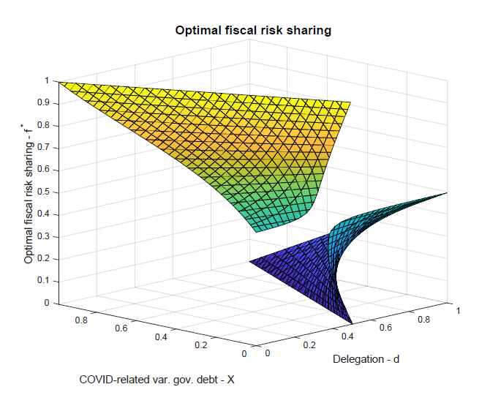
OUR ADDITIONAL RESULTS
The optimal sharing/delegation mix depends not monotonically on the level of debt a country incurs into

Slide 11
OUR ADDITIONAL RESULTS (cont.)
When delegation is expensive, f*>1/2 and it is optimal to do more risk sharing as debt increases, keeping delegation to a minimum independently of debt levels.
When delegation is cheap, f*<1/2 and more
delegation is desirable but a lot can be gained
by increasing delegation as debt increases, in place of risk sharing.

Slide 12
CONCLUSIONS
The COVID-19 pandemics has produced an asymmetric shock in EU. Initial conditions also asymmetric.
Given this, the EU has an incentive to provide some forms of risk sharing in response to increased sovereign risk
Optimal design needs to counterbalance moral hazard and depends on the costs of delegation of fiscal authority
The larger the resources that are needed at national level, the larger the desirability of further fiscal integration
Key to understand costs of delegation, since these play a big role in deciding how much risk is optimal to share

Slide 13
FURTHER RESEARCH
Costs of risk sharing
Benefits of delegation to attain common goals, e.g. zero-carbon transitions
THANK YOU!
REFERENCES
https://www.imf.org/en/Publications/WP/Issues/2020/09/04/Reducing-Risk-While-Sharing-It-A-Fiscal-Recipe-for-The-EU-at-the-Time-of-COVID-19-49614

